Slide 1
CAPSTONE PROJECT REGRESSION AND CLASSIFICATION TASK
TEAM 4
MEMBERS:
Shrijal Shrestha
Deepshikha Singh
Sakar Rayamajhi

Slide 2
REGRESSION TASK
PREDICTION OF AUTOMOBILE MILEAGE PER GALLON OF FUEL
DATA ACQUISITION FROM KAGGLE
DATA CLEANING AND PREPROCESSING
EDA- VISUALIZATION
ENCODING CATEGORICAL VARIABLES
MODEL SELECTION- LINEAR REGRESSION
TRAIN TEST SPLIT OF DATA – 80/20
MODEL TRAINING
METRICS EVALUATION- MSE, RMSE, R SQUARED
DEPLOYMENT IN STREAMLIT

Slide 3
CLASSIFICATION TASK
PREDICTION OF SPANISH WINE QUALITY
DATA ACQUISITION FROM KAGGLE
DATA CLEANING AND PREPROCESSING
EDA- VISUALIZATION
ENCODING CATEGORICAL VARIABLES
MODEL SELECTION- DECISION TREE CLASSIFIER
TRAIN TEST SPLIT OF DATA- 80/20
MODEL TRAINING
METRICS EVALUATION- CONFUSION MATRIX, ACCURACY, PRECISION, F1 VALUE, RECALL
DEPLOYMENT IN STREAMLIT

Slide 4
DATA CLEANING AND PREPROCESSING
FOR REGRESSION TASK, THE AUTOMOBILE MPG DATASET HAD
NO MISSING VALUES AND NO DUPLICATE ENTRIES
GOOD QUALITY DATASET
FOR CLASSIFICATION TASK, THE SPANISH WINE DATASET HAD
MULTIPLE MISSING ENTRIES -1169
MULTIPLE DUPLICATE VALUES (POOR QUALITY DATA)- 5452
HEAVY CLEANING AND PREPROCESSING WAS REQUIRED

Slide 5
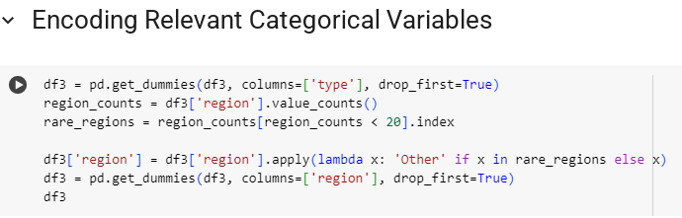
ENCODING CATEGORICAL VARIABLES
CATEGORICAL VARIABLES LIKE WINE TYPE AND REGION OF ORIGIN WERE ENCODED INTO NUMERIC VALUES

Slide 6
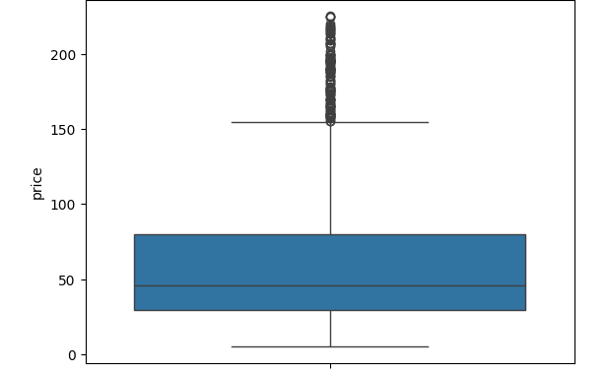
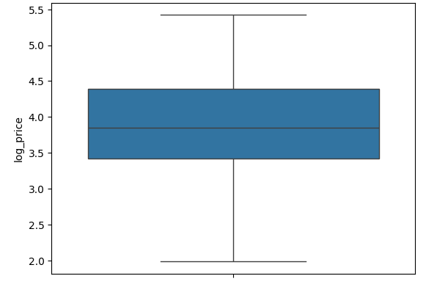
OUTLIER DETECTION AND HANDLING
- LOG TRANSFORMATION WAS COMBINED WITH IQR METHOD

Slide 7
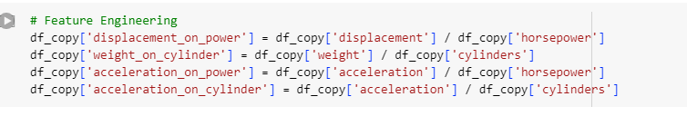
FEATURE ENGINEERING
- FEATURE ENGINEERING WAS PERFORMED TO DERIVE NEW FEATURES SUCH AS WEIGHT ON CYLINDER AND ACCELERATION ON POWER FROM PRE EXISTING FEATURES

Slide 8
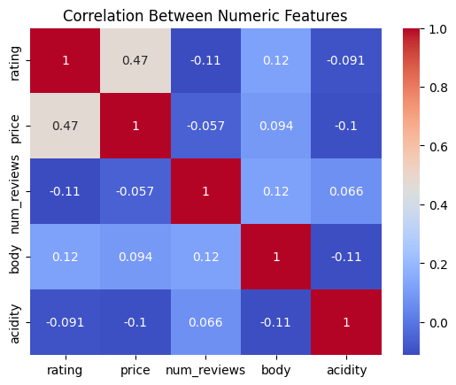
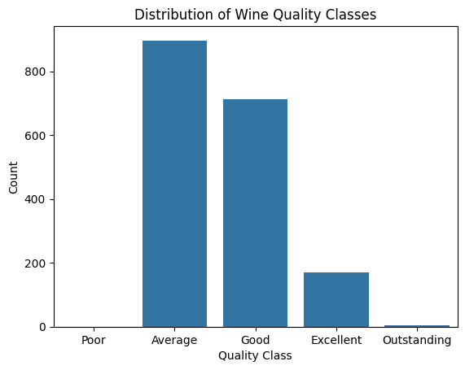
VISUALIZATION

Slide 9
MODEL SELECTION
DECISION TREE CLASSIFIER AND LINEAR REGRESSION MODELS

Slide 10
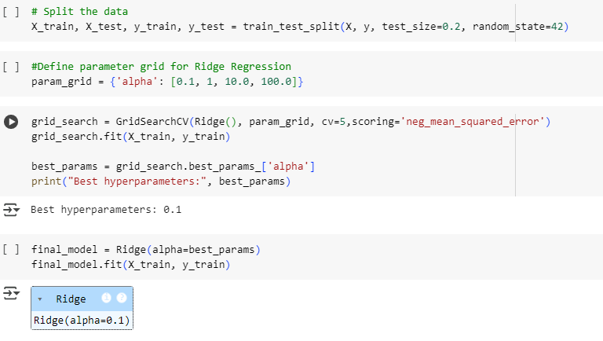
TRAINING AND TUNING HYPERPARAMETERS FOR REGRESSION TASK

Slide 11
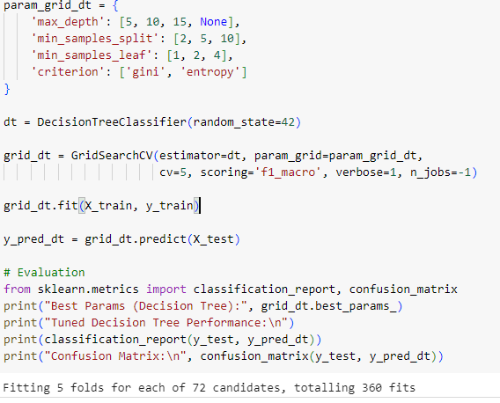
TRAINING AND TUNING HYPERPARAMETERS FOR CLASSIFICATION TASK

Slide 12
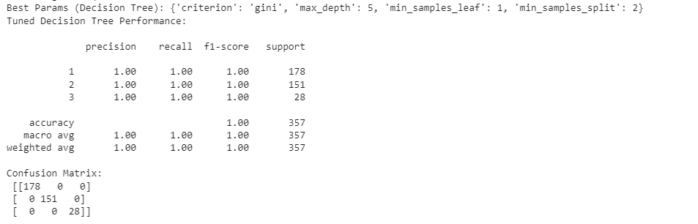
PERFORMANCE METRICS

Slide 13
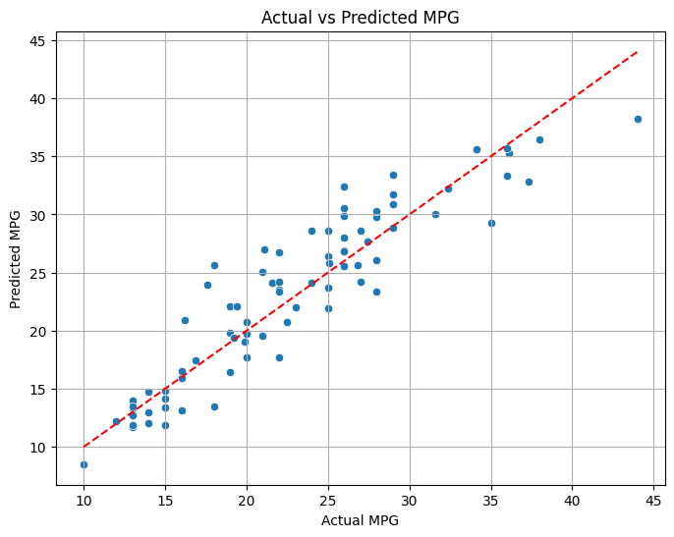
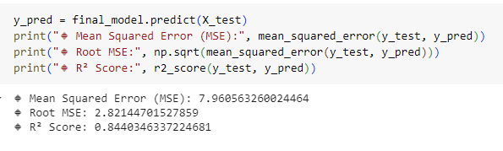
PERFORMANCE METRICS

Slide 14
DEPLOYMENT IN STREAMLIT

